Slide 1
UNIT- VI Security n Application Development

Slide 2
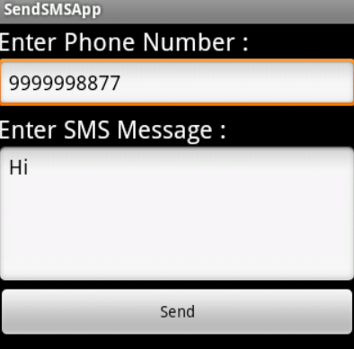
SMS Telephony
In Android, use SmsManager API or devices Built-in SMS application to send SMS's.

Slide 3
Sending SMS using SmsManager API :
SmsManager smsManager1 = SmsManager.getDefault(); smsManager1.sendTextMessage("phoneNo", null, "sms message", null, null);
sendTextMessage Syntax :
public void sendTextMessage (String destinationAddress, String scAddress, String text, PendingIntent sentIntent, PendingIntent deliveryIntent)
destinationAddress: You need to specify mobile number of the recipient.
ServiceCenterAddress: You need to specify service center address. You can use null for default
text: You need to specify the content of your message.
sentIntent: specify Pending Intent to invoke when the message is successfully sent
deliveryIntent: specify the Pending Intent to invoke when the message is delivered to the recipient.
Manifest File :
<uses-permission android:name="android.permission.SEND_SMS"/>

Slide 4
A Pending Intent is a token you give to some app to perform an action on your apps' behalf irrespective of whether your application process is alive or not.
By giving a PendingIntent to another application, you are granting it the right to perform the operation you have specified.
Example : ordering app uses a PendingIntent rather than sending an activity result because it could take a significant amount of time for the order to be delivered, and it doesn’t make sense to force the user to wait while this is happening.
The difference between PendingIntent and Intent: An Intent is something that is used right now; a PendingIntent is something that may create an Intent in the future. You will use a PendingIntent with Notifications

Slide 5
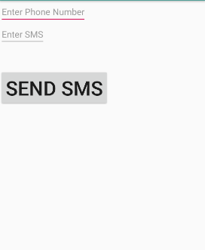
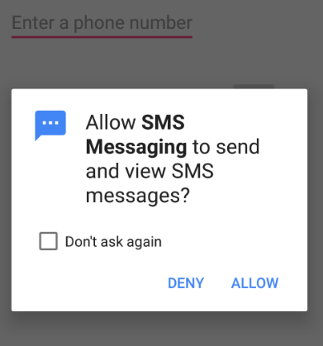
Sending SMS using SmsManager API
Permission in Manifest :
<uses-permission android:name="android.permission.SEND_SMS" />
Button bt1; EditText phone_no; EditText msg; String phoneno , message; @Override protected void onCreate(Bundle savedInstanceState) { super.onCreate(savedInstanceState); setContentView(R.layout.activity_sms__api_exmaple1); bt1= (Button)findViewById(R.id.btnSendSMS); phone_no=(EditText)findViewById(R.id.editphono); msg=(EditText)findViewById(R.id.editmsg); bt1.setOnClickListener(new View.OnClickListener() { @Override public void onClick(View v) { sendSMSMessage(); } }); } }

Slide 6
protected void sendSMSMessage() { phoneno=phone_no.getText().toString(); message= msg.getText().toString(); SmsManager smsManager 1= SmsManager.getDefault(); // get the default instance of SmsManager class smsManager1.sendTextMessage(phoneno, null, message, null, null); Toast.makeText(getApplicationContext(), "SMS sent.", Toast.LENGTH_LONG).show();

Slide 7
SMS by Intent : Built-in SMS application
Intent sendIntent = new Intent(Intent.ACTION_VIEW); //Intent Object - Action to send SMS
//To send an SMS you need to specify smsto: as URI using setData() method
sendIntent.setData(Uri.parse("smsto:"));
sendIntent.putExtra("sms_body", "default content");
//This is used to create intents that only specify a type and not data, for example to indicate the type of data to return
// data type will be to vnd.android-dir/mms-sms using setType()
sendIntent.setType("vnd.android-dir/mms-sms");
Intent.putExtra("sms_body" , "Test SMS to Angilla");
startActivity(sendIntent);

Slide 8
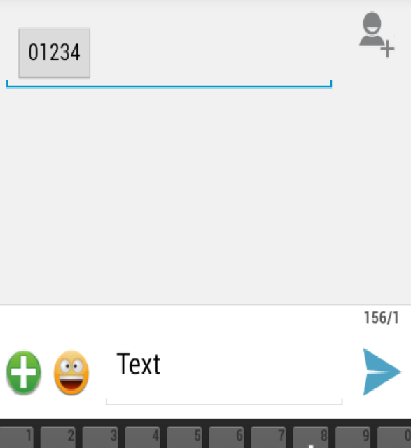
SMS by Intent –Exp -29
protected void sendSMS() {
Log.i("Send SMS", "");
Intent smsIntent = new Intent(Intent.ACTION_VIEW); smsIntent.setData(Uri.parse("smsto:"));
smsIntent.setType("vnd.android-dir/mms-sms");
smsIntent.putExtra("address" , new String (“9856342366"));
//smsIntent.setData(Uri.parse("smsto:" + phoneNumber))
smsIntent.putExtra("sms_body" , "Test ");
try { startActivity(smsIntent);
finish();
}
catch (android.content.ActivityNotFoundException ex) {
Toast.makeText(MainActivity.this, "SMS faild, please try again later.", Toast.LENGTH_SHORT).show(); } }
//setType : Set an explicit MIME data type.
This is used to create intents that only specify a type and not data, for example to indicate the type of data to return
//How different parts of a message, such as text and image, are combined into the message.

Slide 9
Sending Email
Email is messages distributed by electronic means from one system user to one or more recipients via a network.
write an Activity that launches existing an email client(Gmail), using an implicit Intent with the right action and data.
Intent Object - Action
Intent emailIntent = new Intent(Intent.ACTION_SEND);
Intent Object - Data/Type
emailIntent.setData(Uri.parse("mailto:")); emailIntent.setType("text/plain");
Intent Object - Extra
Android has built-in support to add TO, SUBJECT, CC, TEXT etc. fields which can be attached to the intent before sending the intent to a target email client.

Slide 10
Sr.No. | Extra Data & Description
1 | EXTRA_BCC A String[] holding e-mail addresses that should be blind carbon copied.
2 | EXTRA_CC A String[] holding e-mail addresses that should be carbon copied.
3 | EXTRA_EMAIL A String[] holding e-mail addresses that should be delivered to.
4 | EXTRA_HTML_TEXT A constant String that is associated with the Intent, used with ACTION_SEND to supply an alternative to EXTRA_TEXT as HTML formatted text.
5 | EXTRA_SUBJECT A constant string holding the desired subject line of a message.

Slide 11
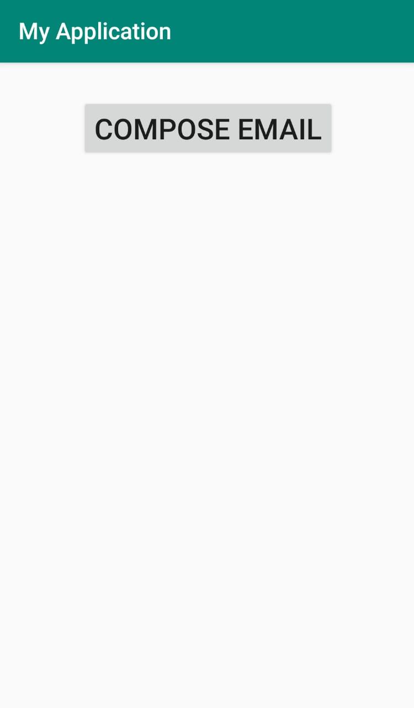
Exp - 30
<LinearLayout xmlns:android="http://schemas.android.com/apk/res/android" xmlns:app="http://schemas.android.com/apk/res-auto" xmlns:tools="http://schemas.android.com/tools" android:layout_width="match_parent" android:layout_height="match_parent" android:id="@+id/l1" android:orientation="vertical" tools:context="MainActivity"> <Button android:id="@+id/sendEmail" android:layout_width="wrap_content" android:layout_height="wrap_content" android:text="Compose Email" android:textSize="25dp" android:layout_marginTop="30dp" android:layout_marginLeft="70dp" /> </LinearLayout>

Slide 12
public void onClick(View view) {
sendEmail();
}
protected void sendEmail() { Log.i("Send email", "");
String[] TO = {“abc@gmail.com"}; String[] CC = {“xyz@gmail.com"};
Intent emailIntent = new Intent(Intent.ACTION_SEND); emailIntent.setData(Uri.parse("mailto:"));
emailIntent.setType("text/plain");
emailIntent.putExtra(Intent.EXTRA_EMAIL, TO
emailIntent.putExtra(Intent.EXTRA_CC, CC);
emailIntent.putExtra(Intent.EXTRA_SUBJECT, "Your subject"); emailIntent.putExtra(Intent.EXTRA_TEXT, "Email message goes here");
try { startActivity(Intent.createChooser(emailIntent, "Send mail...")); // title that will be displayed in the chooser
finish(); Log.i("Finished sending email...", ""); }
catch (android.content.ActivityNotFoundException ex)
{ Toast.makeText(MainActivity.this, "There is no email client installed.", Toast.LENGTH_SHORT).show(); } } }
Note : The chooser enables the user to pick another mail application than the default. Its very useful if you use normal gmail (privat) and email (work related) and you want to choose which one to take.
user has both Chrome and Firefox installed on their Android device. user is presented with a chooser, so the user can choose which of the two Web browsers to use.

Slide 13
Google Map
Android allows us to integrate Google Maps in our application. For this Google provides us a library via Google Play Services for using maps.
In order to use the Google Maps API, you must register your application on the Google Developer Console and enable the API.
Google Maps API :
Is a robust tool , helps you take the power of Google Maps and put it directly on your own site.
It lets you add relevant content that is useful to your visitors and customize the look and feel of the map to fit with the style of your site.
Api key : need access to the Google Maps API key. Without this key, you will not be able to display Google Maps on your app.

Slide 14
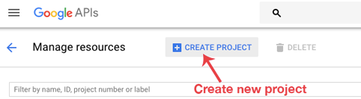
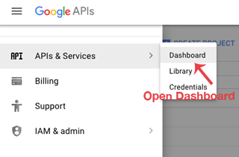
Steps to get API Key
Step 1: Open Google developer console and sign in with your gmail account: https://console.developers.google.com/project.
Step 2: Now create new project. You can create new project by clicking on the Create Project button and give name to your project.
Step 3: Now click on APIs & Services and open Dashboard from it.

Slide 15
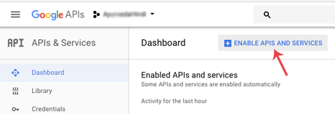
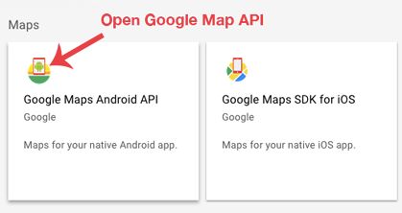
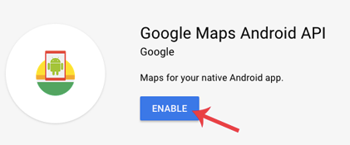
Step 4: In this open Enable APIS AND SERVICES.
Step 5: Now open Google Map Android API
Step 6: Now enable the Google Maps Android API.

Slide 16
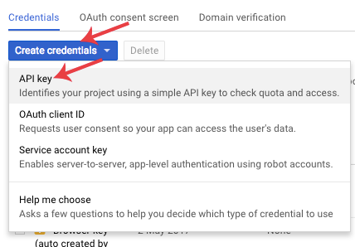
Step 6: Now go to Credential
Step 7: Here click on Create credentials and choose API key
Now API your API key will be generated. Copy it and save it somewhere as we will need it when implementing Google Map in our Android project.

Slide 17
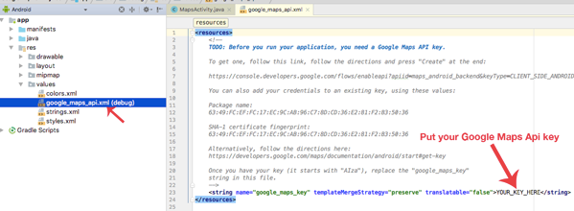
Now open google_maps_api.xml (debug) in values folder. Here enter your Google Maps API key in place of YOUR_KEY_HERE

Slide 18
Permissions
define internet and location permissions in Android Manifest.
INTERNET – To determine if we are connected to Internet or not. ACCESS_FINE_LOCATION – To determine user’s location using GPS. It will give us precise location.
ACCESS_COARSE_LOCATION — Allows an app to access approximate location.
<uses-permission android:name="android.permission.ACCESS_FINE_LOCATION"/>
<uses-permission android:name="android.permission.INTERNET"/>

Slide 19
MapsActivity.java file : callbacks in Google Maps:
OnMapReady Callback: This callback is called when the map is ready to be used
This is where we can add markers or lines, add listeners or move the camera
@Override
public void onMapReady(GoogleMap googleMap) {}
Connection/Suspend Callbacks: This callback is called whenever device is connected and disconnected and implement onConnected() and onConnectionSuspended() functions.
//When the connect request has successfully completed
@Override
public void onConnected(Bundle bundle) {}
//Called when the client is temporarily in a disconnected state.
@Override
public void onConnectionSuspended(int i) {
}
OnConnectionFailedListener: Provides callbacks for scenarios that result in a failed attempt to connect the client to the service. Whenever connection is failed onConnectionFailed() will be called.
@Override
public void onConnectionFailed(ConnectionResult connectionResult) {
}
LocationListener: This callback have function onLocationChanged() that will be called whenever there is change in location of device.

Slide 20
Method of Google Map to customize map
Google map API methods help to customize google map
addMarker() : add marker to map
addCircle() : add circle to map
addPolygon():add polygon
getMyLocation(): return the currently displayed user location.
Movecamera(): reposition the camera
setTrafficEnabled() : set traffic layer on or off.

Slide 21
ZOOM Control
State syntax to display built in zoom control. (2M)
a) Built in Zoom control in Google map can be displayed with :
The Maps API provides built-in zoom controls that appear in the bottom right hand corner of the map. These can be enabled by calling:
UiSettings.setZoomControlsEnabled(true);
b) In any normal activity, ZoomControl can be displayed as component by following syntax :
ZoomControl zoomControls = (ZoomControl) findViewById(R.id.simpleZoomControl);
zoomControls.show()
Methods:
Hide(): hide ZoomControls from screen
Show():show ZoomControls.

Slide 22
Changing the Map Type:
mMap.setMapType(GoogleMap.MAP_TYPE_NORMAL);
MAP_TYPE_NORMAL : Represents a typical road map with street names and labels.
MAP_TYPE_SATELLITE: Represents a Satellite View Area without street names and labels.
MAP_TYPE_TERRAIN: Topographic data. The map includes colors, contour lines and labels, and perspective shading. Some roads and labels are also visible.
MAP_TYPE_HYBRID : Combines a satellite View Area and Normal mode displaying satellite images of an area with all labels.
Map_TYPE_NONE : No tiles. It is similar to a normal map, but doesn’t display any labels or coloration for the type of environment in an area.

Slide 23
Location Based Services
To update location
requestLocationUpdates() :
Create Instance of LocationManager class and request location updates using requestLocationUpdates() method.
Eg : locationmgr1.requestLocationUpdates(LocationManager.GPS_PROVIDER , 0 , 0 , this);
Set type of location provider , number of seconds , distance and location listener object over which the location to be updated.
// update when the location has changed by distance in meters, AND byTime in milliseconds have passed.
onLocationChanged() call back method :
Whenever user’s location is changed. For that Google has predefined function onLocationChanged that will be called as soon as user’s location change. Here we are getting the coordinates of current location using getLatitude() and getLongitude()
Eg : public void onLocationChanged ( Location location)
Location class Object (location) : it signifies a geographic location which consist of latitude ,longitude , time stamp.
Methods of Location Class :
getLatitude():get latitude in degree.
getLongitude(): get longitude in degree.
getAccuracy():get accuracy in meters.
getSpeed(): get speed in meters/second .

Slide 24
Show marker on a location
Addmarker ():
Create instance of GoogleMap and call AddMarker method . Use Latlng class object to define the position to add the marker.
//This callback is triggered when the map is ready to be used.
public void onMapReady(GoogleMap googleMap) { mMap = googleMap; // Add a marker in Sydney and move the camera LatLng sydney = new LatLng(-34, 151); // define instance of LatLng class and add postion mMap.addMarker(new MarkerOptions().position(sydney).title("Marker in Sydney")); mMap.moveCamera(CameraUpdateFactory.newLatLng(sydney));

Slide 25
Steps to get location in Android :
1. Provide permission in manifest for receiving location update.
<uses-permission
android:name="android.permission.INTERNET" />
<uses-permission android:name="android.permission.ACCESS_COARSE_LOCATION" />
<uses-permission android:name="android.permission.ACCESS_FINE_LOCATION" />

Slide 26
2. Create location Manager instance as reference to the location service.
Eg : location_Manager1=(LocationManager)getSystemService(Context.LOCATION_SERVICE) // LOCATION_SERVICE reference will be created.
3.Request current location from location manager:
// location updates are requested
location_Manager1.requestLocationUpdates(LocationManager.GPS_PROVIDER , 0 , 0 , this);
Parameters : location provider , number of seconds , distance ,
object over which the location to be updated
4. Receive location update
Update is notified.
onLocationChanged(Location location)
Text1.settext=(“Latitude” + location.getLatitude() + “Longitude : “ +location.getLongitude());

Slide 27
To display Map
1. Map view : use <mapView> in XML
Java code :
public class MapsActivity extends AppcompatActivity implements OnMapReadyCallback {
MapView mapview1;
Void onCreate(Bundle saveInstanceState) {
mapview1=findViewById(R.id.map_view);
mapview1.getMapAsync(this);
}

Slide 28
2. SupportMapFragment : create google map activity . A Map component in an app . automatically handle the necessary life cycle needs. Being a fragment, this component can be added to an activity's layout file simply with the XML below.
XML :
<fragment
name="com.google.android.gms.maps.SupportMapFragment"
android:layout_width="match_parent"
android:layout_height="match_parent“
android:id=“@+id/fragment”
/>
Java code :
public class MapsActivity extends AppcompatActivity implements OnMapReadyCallback {
Void onCreate(Bundle saveInstanceState) {
SupportMapFragment mapFragment = (SupportMapFragment) getSupportFragmentManager().findFragmentById(R.id.fragment);
mapFragment.getMapAsync(this);
}}

Slide 29
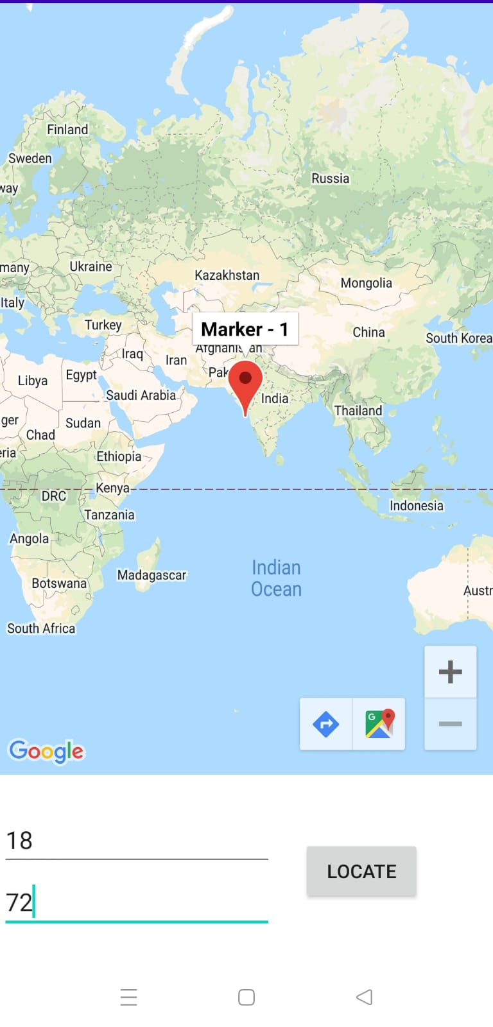
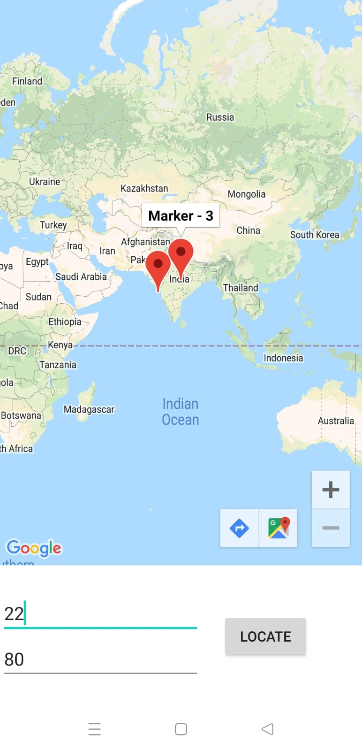
Navigating to a Specific Location, Set/Unset Zoom Controls

Slide 30
Navigating to a Specific Location, Set/Unset Zoom Controls
XML :
<LinearLayout>
<fragment
class="com.google.android.gms.maps.SupportMapFragment“
android:id=“@+id/fragment”
android:layout_width="match_parent"
android:layout_height="match_parent"/>
<EditText
android:id=“@+id/ ed_lat”/>
<EditText
android:id=“@+id/ ed_long”/>
<Button
android:id=“@+id/l=b1”/>

Slide 31
Navigating to a Specific Location, Set/Unset Zoom Controls
public class MapsActivity extends AppCompatActivity implements OnMapReadyCallback { private GoogleMap mMap; EditText la, lo; int count = 0; Button b1; @Override protected void onCreate(Bundle savedInstanceState) { super.onCreate(savedInstanceState); setContentView(R.layout.activity_map); SupportMapFragment mapFragment = (SupportMapFragment) getSupportFragmentManager().findFragmentById(R.id.fragment); mapFragment.getMapAsync(this); }

Slide 32
public void onMapReady(GoogleMap googleMap) { mMap = googleMap; lo = findViewById(R.id.ed_long); la = findViewById(R.id.ed_lat); b1 = findViewById(R.id.b1); b1.setOnClickListener(new View.OnClickListener() { @Override public void onClick(View v) { count++;
//LatLang is a class LatLng temp = new LatLng(Float.parseFloat(la.getText().toString()), Float.parseFloat(lo.getText().toString()));
mMap.addMarker(new MarkerOptions().position(temp).title("Marker - " + count)); mMap.moveCamera(CameraUpdateFactory.newLatLng(temp)); } });
mMap.getUiSettings().setZoomControlsEnabled(true); //displays + - option used to zoom in & out on map (default - false)
mMap.getUiSettings().setZoomGesturesEnabled(false); //sets the pinch in & out gestures (default - true)
mMap.getUiSettings().setCompassEnabled(false); //sets the compass gesture, visible when map is rotated (default - true)

Slide 33
Geocode and Reverse Geocoding
Geocode : finding the geographical co ordinate (latitude and longitude) of a given location is called Geocode.
Reverse Geocode :
opposite of geocode.
Pair of latitude and longitude is converted into location called Reverse Geocode.
Methods of Geocoder class
getFromLocationName()
getFromLocation()

Slide 34
Geocoder : A class for handling geocoding and reverse geocoding.
Geocoding is the process of transforming a street address or other description of a location into a (latitude, longitude) coordinate.
Reverse geocoding is the process of transforming a (latitude, longitude) coordinate into a (partial) address.
The amount of detail in a reverse geocoded location description may vary, for example one might contain the full street address of the closest building, while another might contain only a city name and postal code.

Slide 35
a. getFromLocation
Syntax
public List<Address> getFromLocation (double latitude, double longitude, int maxResults)
This method returns an array of Addresses that attempt to describe the area immediately surrounding the given latitude and longitude.
b. getFromLocationName
Syntax :
● public List<Address> getFromLocationName (String locationName, int maxResults)
Returns an array of Addresses that attempt to describe the named location, which may be a place name such as "Dalvik, Iceland", an address such as "1600 Amphitheatre Parkway, Mountain View, CA", an airport code such as "SFO", and so forth.

Slide 36
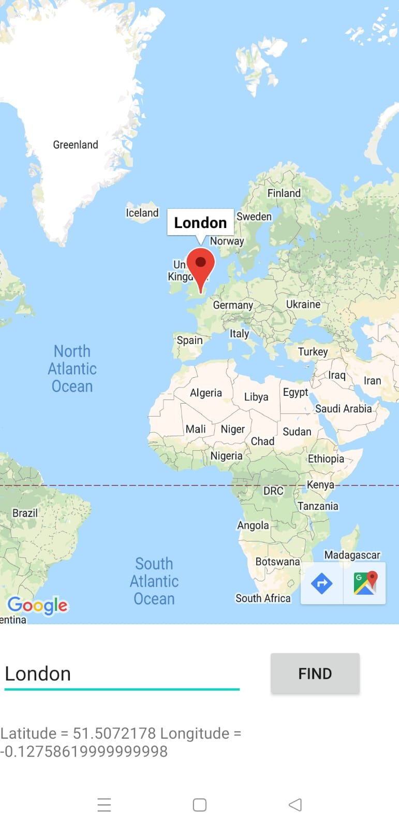
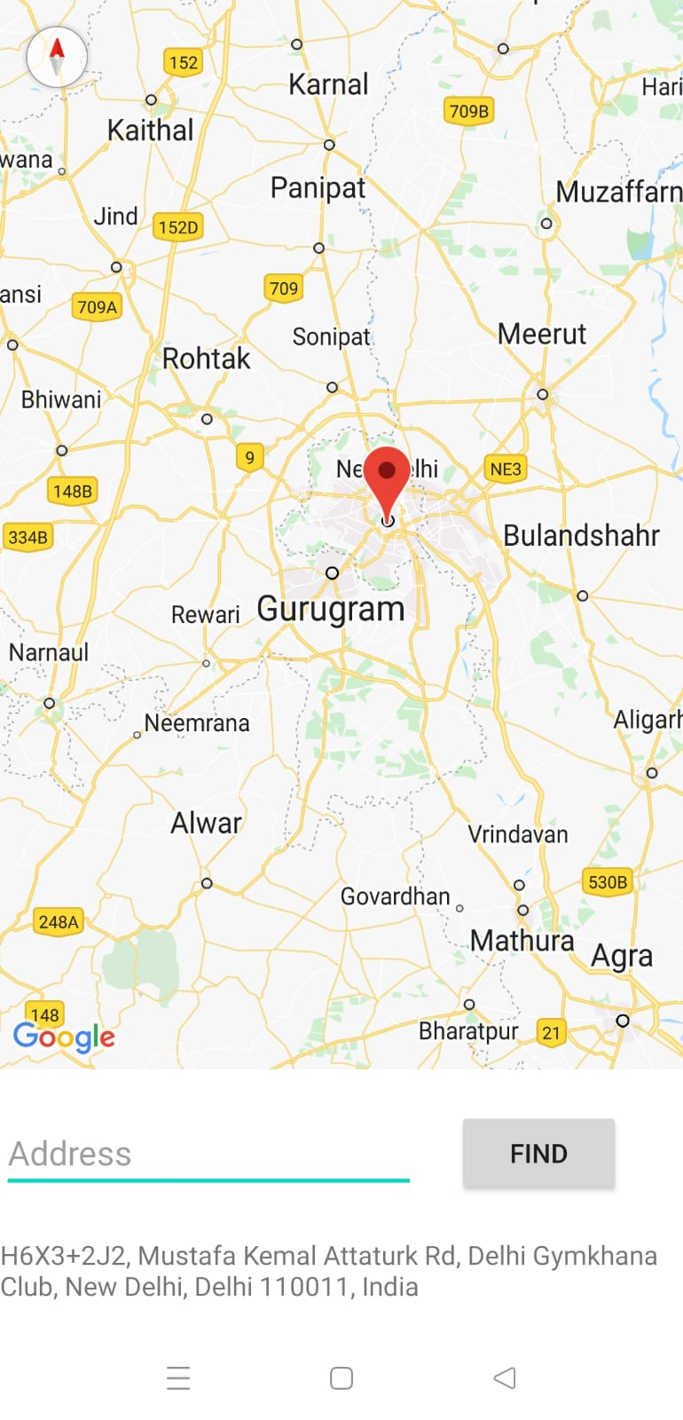
GeoCode Reverse GeoCode

Slide 37
Geocoding & Reverse Geocoding
.
public class MapsActivity extends AppcompatActivity implements OnMapReadyCallback { private GoogleMap mMap; private Geocoder geo; EditText ed_ad; Button b1; TextView t1; @Override protected void onCreate(Bundle savedInstanceState) { super.onCreate(savedInstanceState); setContentView(R.layout.); // SupportMapFragment : Creates a map fragment. SupportMapFragment mapFragment = (SupportMapFragment) getSupportFragmentManager().findFragmentById(R.id.map);
// Sets a callback object which will be triggered when the GoogleMap instance is ready to be used mapFragment.getMapAsync(this);
geo = new Geocoder(this); ed_ad = findViewById(R.id.ed_ad); b1 = findViewById(R.id.b1); t1 = findViewById(R.id.t1); }

Slide 38
//Geocoding to find lat,long from address b1.setOnClickListener(new View.OnClickListener() { @Override public void onClick(View v) { try { List<Address> addresses = geo.getFromLocationName(ed_ad.getText().toString(), 1); if(addresses.size()>0){ Address ads = addresses.get(0); // get value of 0th index address list like : roadno
LatLng latlo = new LatLng(ads.getLatitude(), ads.getLongitude()); t1.setText("Latitude = "+ads.getLatitude()+" Longitude = "+ads.getLongitude());
mMap.addMarker(new MarkerOptions().position(latlo).title(ads.getLocality())); mMap.moveCamera(CameraUpdateFactory.newLatLng(latlo)); } } catch (IOException e) { e.printStackTrace(); } } });

Slide 39
//REVERSE GEO-CODING (to find address from lat,long)
mMap.setOnMapLongClickListener(new GoogleMap.OnMapLongClickListener() { @Override public void onMapLongClick(@NonNull LatLng latLng) {
Toast.makeText(getApplicationContext(), latLng.toString(), Toast.LENGTH_SHORT).show(); try { List<Address> addresses = geo.getFromLocation(latLng.latitude, latLng.longitude, 1); if (addresses.size()>0){ Address ads = addresses.get(0); String txt = ads.getAddressLine(0); mMap.addMarker(new MarkerOptions().position(latLng).title(txt)); t1.setText(txt); } } catch (IOException e) { e.printStackTrace(); } } });

Slide 40
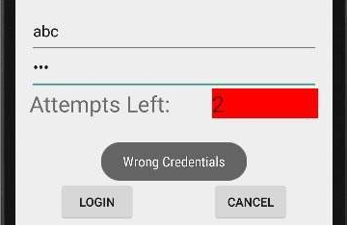
Exp 27-28 :Login Validation
public class MainActivity extends AppCompatActivity { Button b1,b2; EditText ed1,ed2; TextView tx1; int counter = 3; @Override protected void onCreate(Bundle savedInstanceState) { super.onCreate(savedInstanceState); setContentView(R.layout.activity_main); b1 = (Button)findViewById(R.id.button); ed1 = (EditText)findViewById(R.id.editText); ed2 = (EditText)findViewById(R.id.editText2); b2 = (Button)findViewById(R.id.button2); tx1 = (TextView)findViewById(R.id.textView3); tx1.setVisibility(View.GONE);

Slide 41
b1.setOnClickListener(new View.OnClickListener() { @Override
public void onClick(View v) { if(ed1.getText().toString().equals("admin") && ed2.getText().toString().equals("admin")) { Toast.makeText(getApplicationContext(), "Redirecting...",Toast.LENGTH_SHORT).show(); }else{ Toast.makeText(getApplicationContext(), "Wrong Credentials",Toast.LENGTH_SHORT).show(); tx1.setVisibility(View.VISIBLE); tx1.setBackgroundColor(Color.RED); counter--; tx1.setText(Integer.toString(counter)); if (counter == 0) { b1.setEnabled(false); } } } });

Slide 42
Android Security Model :Permission
The purpose of a permission is to protect the privacy of an android user.
App permissions help support user privacy by protecting access to the following:
Restricted data, such as SMS and a user's contact information.
Restricted actions, such as connecting to a paired device and recording audio.
Android apps must request permissions to access sensitive user data(contact ,SMS) as well as certain system features(camera , internet).
To make use of protected features of device , must include in AndroidManifest.xml <uses-permission> tags declaring permissions.
Permissions are divided into several protection levels
Protection levels :
--normal
--signature
--dangerous

Slide 43
<manifest xmlns:android="http://schemas.android.com/apk/res/android"
package="com.example.practiceprograms">
<uses-permission android:name="android.permission.SEND_SMS"
android:label=“@string/label_cellphone”
android:description=“@string/desc_cellphone”
android:permissionGroup=“android.permission-group.COST_MONEY”
android:protectionLevel=“dangerous” />
</manifest>
<string name=“label_cellphone”> send SMS</string>
<string name=“desc_cellphone”>allows the app to send SMS</string>
Label and description should be supplied for the permission. These are string resources that can be displayed to the user when they are viewing a list of permissions.
Label The label specifies the name of the permissions to be displayed to users
Description : defines a summary that will be shown to the end-user.what the permission allows a holder to do.

Slide 44
permissionGroup : The permission-group tag allows you to create a group of custom permissions. Declares a name for a logical grouping of related permissions.
If user allows permission from a group and your app requests for second permission from the same group, system will automatically grant the permission.
MESSAGES : The messages related permissions, say android.permission.SEND_SMS, RECEIVE_SMS and all the permissions related to messages are grouped under android.permission-group.MESSAGES
For example, System will automatically grant WRITE_CALENDAR permission without prompting for user acceptance. This is because READ_CALENDAR and WRITE_CALENDAR permissions belong to CALENDAR group.

Slide 45
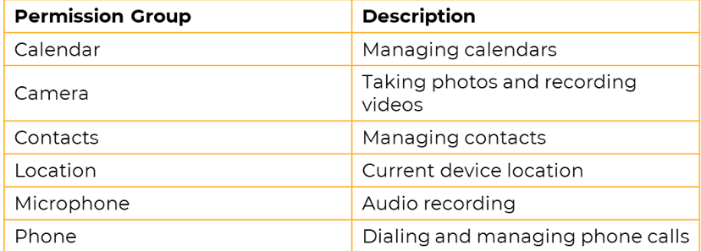

Slide 46
Example of permission group
With permission group :
<permission-group android:name="android.permission-group.MESSAGES"
android:label="@string/permgrouplab_messages"
android:icon="@drawable/perm_group_messages"
android:description="@string/permgroupdesc_messages“/>
Without permission group :
<uses-permission android:name="android.permission.SEND_SMS" />
<uses-permission android:name="android.permission.RECEIVE_SMS" />

Slide 47
Protection levels
1. Normal : cover areas where our app needs to access data outside the apps sandbox , but there are very little risk to the users privacy
Eg : permission to set Time zone is a normal permission on. If app declare in its manifest that it needs a normal permission , the system automatically grants the app that permission at installation time.
Like : ACCESS_NETWORK_STATE , SET_ALARM ,SET_WALLPAPER , INTERNET
2. Signature : the system grant these permissions at install time but only when the app that attempt to use permission is signed by the same certificate as the app that defines the permissions.
It’s granted automatically by the system if both applications are signed with the same certificate
if you write App A that defends itself with a signature-level permission (e.g., a custom one), and you write App B that wants to talk to the defended portions of App A, you can do so, if you are signing App A and App B with the same signing key.
LIKE : BIND_ACCESSIBILITY_SERVICE , WRITE_SETTINGS , WRITE_VOICEMAIL

Slide 48
3. Dangerous : cover areas where the app want data that involves the users private information.
Eg : access to Contact , SMS.
If an app declare that it needs a dangerous permission , the user has to explicitly grant the permission .
LIKE : READ_CONTACT , WRITE_CONTACT , RECORD_AUDIO

Slide 49
Custom Permission
Android allows defining custom permission ..
If you wanted to avoid certain users from starting one of the activities in your application , programmer could do that by defining custom permission.
Define custom permissions for your app to share services with other apps. Like services , broadcast receivers

Slide 50
Become a Publisher : Publishing is a process that makes your Android app available to users
2 main task :
1. Prepare the application for release
Configuring app for release
Building and signing a release version
Testing the release version : Before you distribute your app, you should thoroughly test the release version on at least one target handset device and one target tablet device.
Updating app resource for release : Make sure that all app resources, such as multimedia files and graphics, are updated
Prepare remote servers and services on which app depend on : if your app depends on external servers or services, make sure they are secure and production ready.

Slide 51
2.Release the application to users
Release through an app market place : If you want to distribute your apps to the broadest possible audience such as Google Play
1. Prepare promotional materials: To fully leverage the marketing and publicity capabilities of Google Play, you need to create promotional materials for your app such as screenshots, videos, graphics.
2. Configure options and uploading assets : By configuring various Google Play settings, you can choose the countries you want to reach, the listing languages you want to use, and the price you want to charge in each country.
3. Publish the release version of your app :
Release through a website : make the app available for download on your own website
1. Prepare your app for release.
2. Host the release-ready APK file on your website.
3. Provide a download link to users.

Slide 52
Generate Signed APK for Android App
The Android system needs that all installed applications be digitally signed with a certificate whose private key is owned by the application’s developer.
The Android system applies the certificate as a means of recognizing the author of an application and establishing trust relations between applications.
Signed Apk generates a key and this key can be used to release versions of the app, so it is important to save this key which will be used when the next version of the app is released.
When developers are ready to publish the android application for end-users, they are required to sign it with a suitable private key.
Applications can only be installed when they are signed. Android does not allow unsigned applications to get installed.
Link : https://www.bing.com/videos/search?q=how+to+generate+signed+apk+in+android+studio&view=detail&mid=BFF19BBDE0A9374C0418BFF19BBDE0A9374C0418&FORM=VIRE

Slide 53
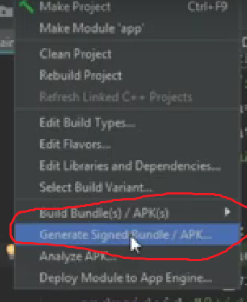
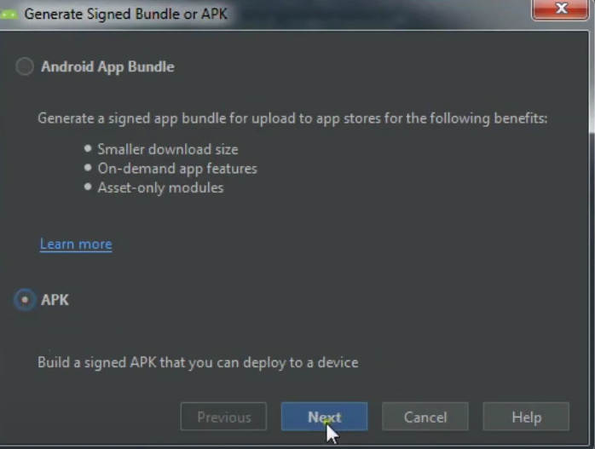
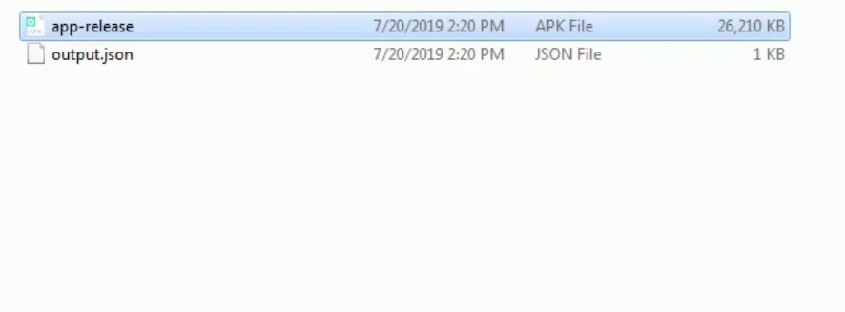
Build -→ Generate Signed Bundle / APK

Slide 54
List and elaborate steps to deploy an Android application on Google play store.
Step 1: Create a Developer Account
Before you can publish any app on Google Play, you need to create a Developer Account.
need to pay a one-time registration fee of $25
Step 2: Plan to Sell? Link Your Merchant Account
If you want to publish a paid app or plan to sell in-app purchases, you need to create a payments center profile, i.e. a merchant account.
manage your app sales and monthly payouts, as well as analyze your sales reports
Step 3: Create an App
Now you have create an application by clicking on 'Create Application'. Here you have to select your app’s default language and type title . Title will show on Google Play after you’ve published
Step 4: Prepare Store Listing
details that will show up to customers on your app’s listing on Google Play.
a.Product Details containing title, short and full description of the app,
Use the right keywords, but don’t overdo it. Make sure your app doesn’t come across as spam-y or promotional, or it will risk getting suspended on the Play Store.

Slide 55
b. Graphic Assets where you can add screenshots, images, videos, promotional graphics, and icons that showcase your app’s features and functionality.
c.Languages & Translations, Categorization where in category can be selected to which your app belong to. Contact Details , Privacy Policy for apps that request access to sensitive user data or permissions,
Step 5: Upload APK to an App Release
Finally upload your app, by uploading APK file. Before you upload APK, you need to create an app release. You need to select the type of release you want to upload your first app version to. You can choose between an internal test, a closed test, an open test, and a production release. The first three releases allow you to test out your app among a select
Step 6: Provide an Appropriate Content Rating
If you don’t assign a rating to your app, it will be listed as ‘Unrated’. Apps that are ‘Unrated’ may get removed from Google Play.
To rate your app, you need to fill out a content rating questionnaire
Step 7: Set Up Pricing & Distribution
set up your app as free or paid.
You can always change your app from paid to free later, but you cannot change a free app to paid. For that, you’ll need to create a new app and set its price.

Slide 56
Step 8: Rollout Release to Publish Your App
Once you’re sure about the correctness of the details, select your app and navigate to ‘Release management’ – ‘App releases.’ You can always opt for reviews by clicking on ‘Review’ to be taken to the ‘Review and rollout release’ screen. Here, you can see if there are any issues or warnings you might have missed out on.
Finally, select ‘Confirm rollout.’

Slide 57
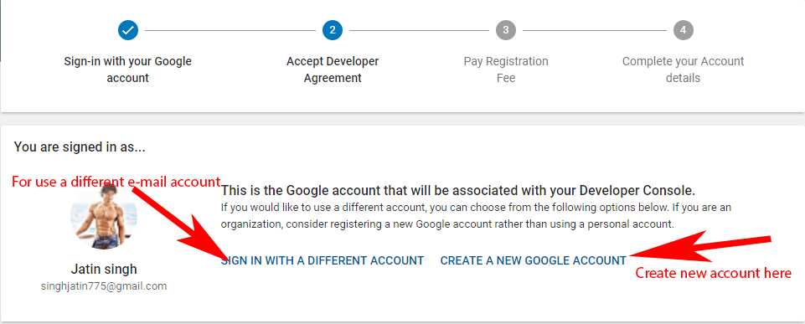
How to publish App on Play Store
First generate signed apk of your Android App to publish it on Play Store.
Now you will need to sign up for Google Play Console to publish and manage your Android App.
Login with your Gmail account that you want to use for publishing App on Play Store.

Slide 58
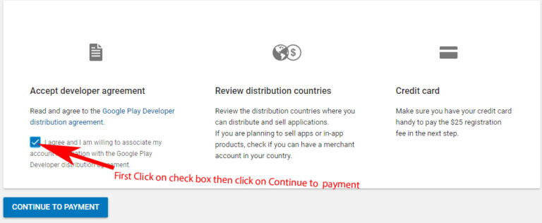
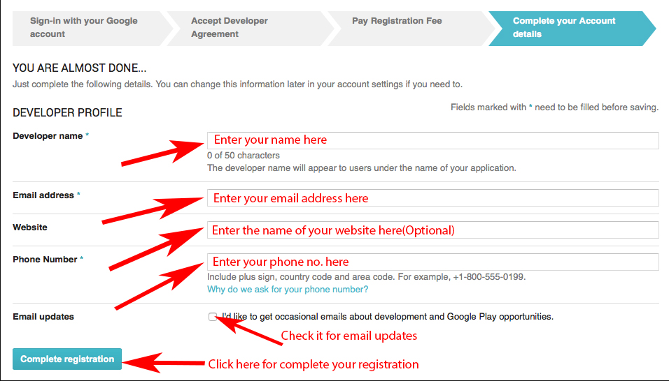
After reading the Google play store developer distribution agreement agree to their terms by clicking on check box
Now you will need to pay one time ‘Developer Registration Fee’ of $25 to Google.
Important Note: You can upload unlimited number of Android App on Play store from single account with a limit of uploading 15 apk/day.
Complete your account details for Google developer account. Now click on Create Application For example see the below image:

Slide 59
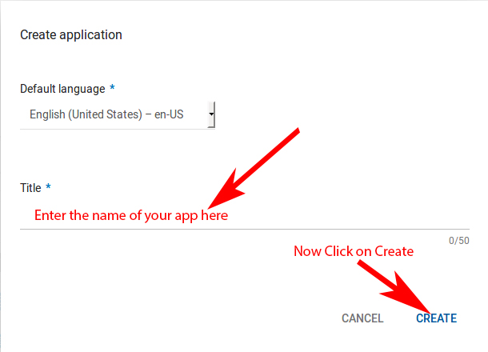
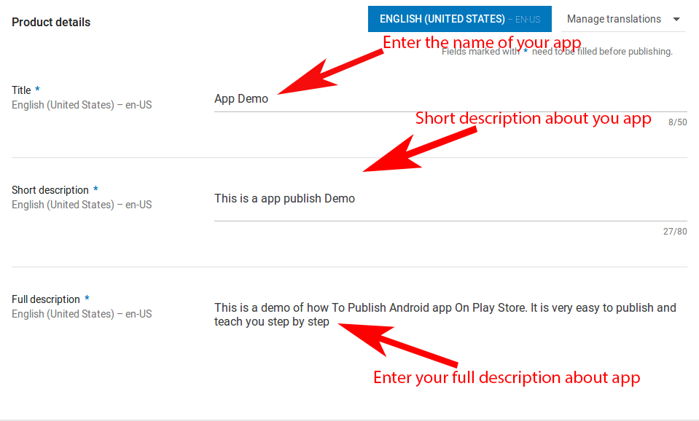
Enter the name of your App.
Now fill store listing details of your App which include Title, Short description, and Full description.

Slide 60

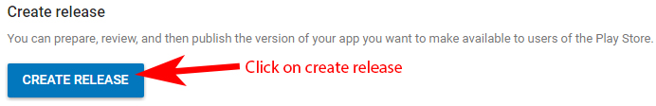
After this you need to put some App screenshots here. The minimum required are 2 screenshots and maximum limit is 8.
After screenshot now you need to put a high Resolution icon or logo with a size of 512 * 512 pixel. This will be displayed on Play Store.
Now scroll down and fill other details which include application type, category, website, email and phone no.
After this check privacy policy because now we are not submitting and then click on save draft. If your App require user permission then it is mandatory to put privacy url.
Click on Save Draft to save your work so far.
After saving data on draft now go to app release and click on manage production.
Now you will see create release now click on it.

Slide 61
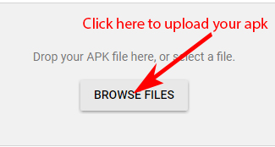
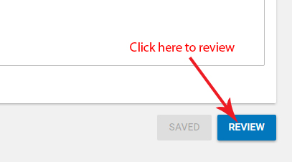
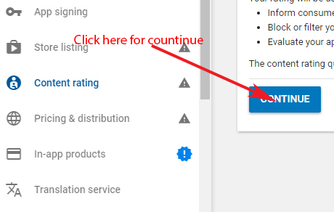
After click on create release you will see browse files click on it and upload your signed APK
Once the upload is successful then scroll down and click on review to check..
Now go to Content Rating and click on continue.

Slide 62
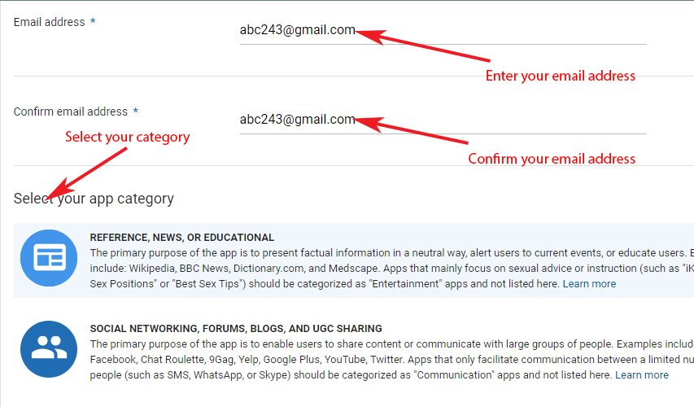
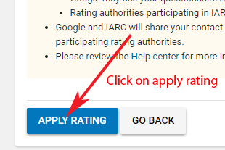
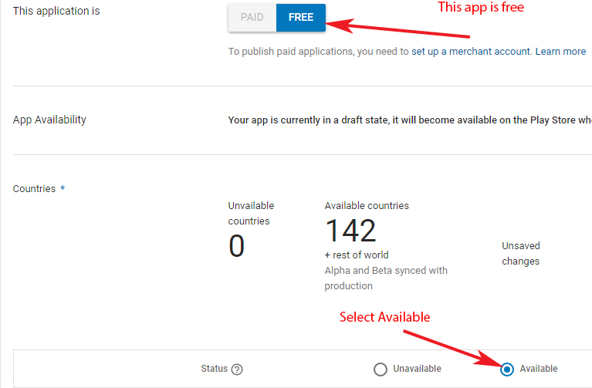
Fill details which include email address and select your categories.
Now click on apply rating
Click on pricing and distribution and select free/paid based on how you want user to access your App.

Slide 63
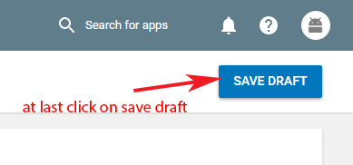
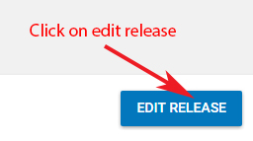
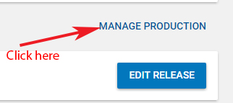
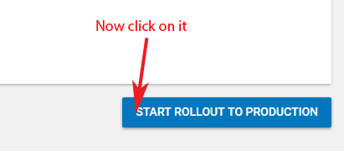
Now scroll down and see mandatory things with * you need to select After this click on save draft
Now Click on ready on publish along with save draft and click on Manage release..
Click on Manage Production.
After Manage production click on edit release.

Slide 64
Browse the site on your browser. https://console. developers. google.com/project
2. Login with your google account.
3. Create a new project by clicking on Create Project option.
4. Add your project name and organization name in the fields present on the screen.
5. Now click on APIs and Services.
6. Enable APIs and services.
7. Select Google maps Android API
8. To create an API key for Maps click on Create credentials option and then select the API key option

Slide 65
State syntax to display built in zoom control. 2M
List and elaborate steps to deploy an Android application on Google play store. 4M
State and elaborate the syntax of required class and methods for Geocoding. 4M
Discuss developer console with at least four features 4M
Write a program to demonstrate declaring and using permissions with any relevant example. 4M
Develop an application to display Google map with user's current location. 6M
Define SMS service in android application development. 2M
Describe the process of getting the map API key. 4M
Describe steps for deploying android application on Google Play Store. 4M
Describe permissions required for android application development. 4M
Develop an android application to show current location of an user's car
4M

